Slide 1
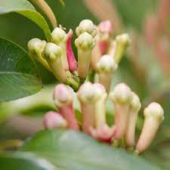
DEPARTMENT OF DRAVYA-GUNA ( JAMC, NAGPUR )
Plant : LAVANG
Guided by : Dr. Seema Parma Ma’am (HOD)
Dr. Shrikant Hadole Sir ( Ass. Prof )
Compiled by : Divya Nagose (2021-22)

Slide 2
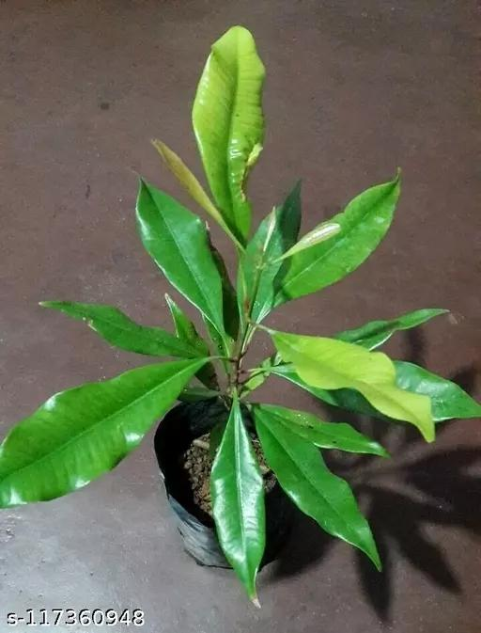
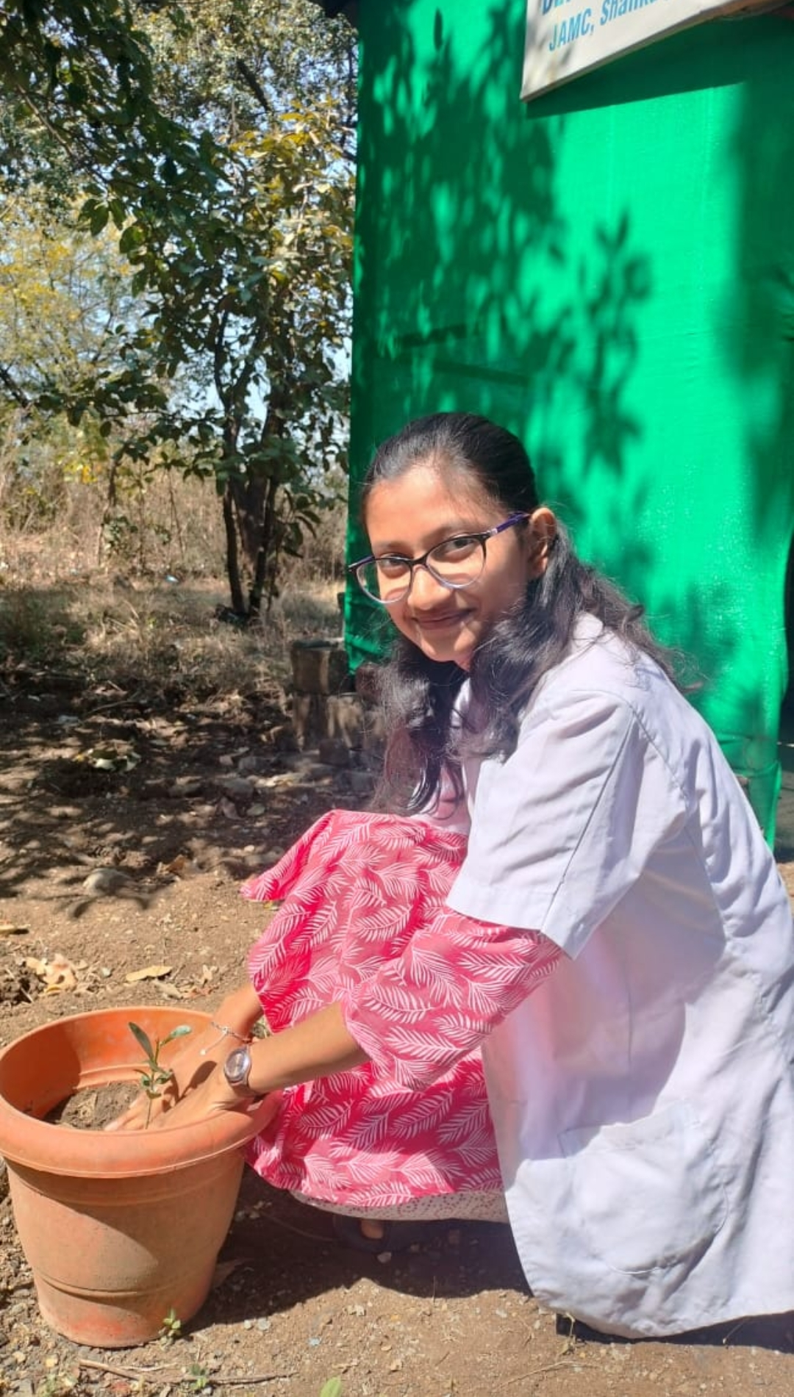
Lavang Images

Slide 3
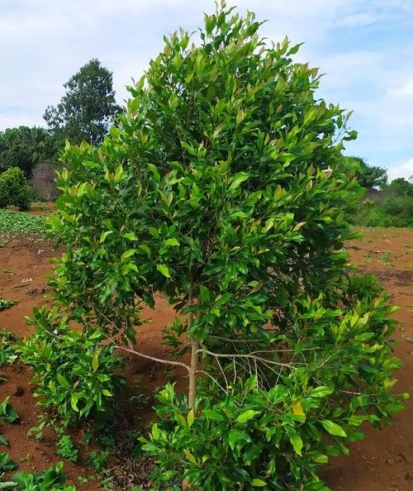
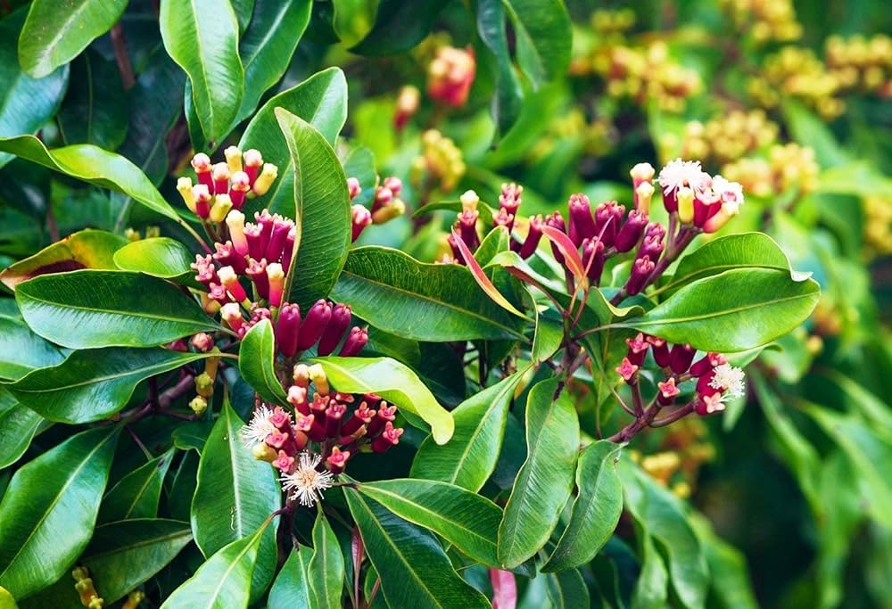
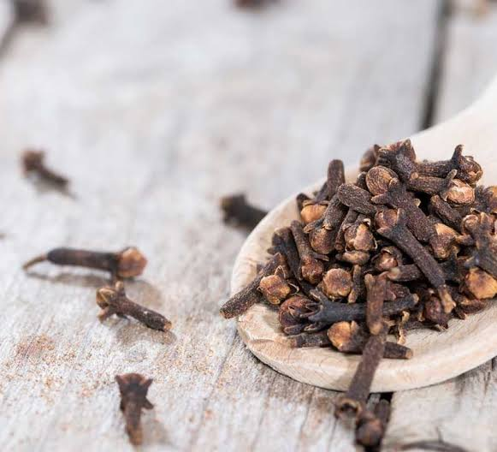
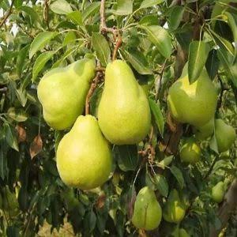
Lavang Images

Slide 4
Scientific name
Syzygium aromaticum Linn. Genus : Syzygium Specific epithet : Aromaticum Linn.
Identified by : Carolus Linnaeus
Family
Myrtaceae (Aromatic shrubs and trees of the topics. )

Slide 5
Taxonomy
Kingdom - Plantae
Division - Magnoliphyta
Class - Magnoliopsida
Order - Myrtales
Family - Myrtaceae
Genus - Syzgium
Species - aromaticum

Slide 6
Ayurveda classification
Charak Samhita
Sushruta Samhita
Ashtang Hrudaya

Slide 7
Historical Importance
Since the structure and curves of a dried clove resemble a nail, their name is derived from the Latin word clavus, which means nail.
Cloves have been a part of traditional medicine and cooking techniques, but scientists have just started looking into their possible health advantages.
The Spice Islands of Indonesia are said to be the native land of Clove in the Moluccas and played a significant role in the early spice trade. Cloves have a strong aroma and a fiery, intense flavour. They are used to flavour various foods, especially meat products and baked goods.
The Clove has been a part of Chinese and Indian traditional medicine systems for ages.

Slide 8
Sanskrit Synonyms and Basonyms
Devakusuma - flowers are used to worship god
Bhringanga, Shekhara, Shri Prasuna - having beautiful flower Chandanapushpaka - flower having fragrance like sandalwood
Varija - usually found in islands
Grahanihara - Cures grahani roga
Srisamja - Lavanga is auspicious

Slide 9
Vernacular Names
Marathi - Lavanga.
Hindi - Lavanga, Long,
Gujrati - Lavang.
Tamil - Kirabu.
Telugu - Karavallu.
English - Clove.

Slide 10
Habitat
In India, it is available in Tamil Nadu and Kerala.
It is abundantly found in Sri Lanka, Mauritius, Tanzania and Singapore.

Slide 11
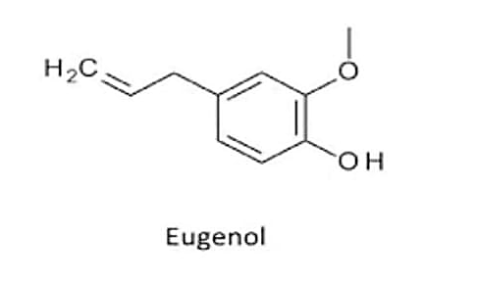
Chemical Composition
Chemical composition -Its oil contains euginol and caryophylline. Lavanga contains adinfe calcium, phosphorus, iron, carotine, thiamine, riboflavin and nicotinic advar acid. Flower stalk contains tannin. Leaves, the fruit and the root contains a volatile oil. Oil of the flowerbuds is used medicinally only.

Slide 12
Rasapanchak
Medicinal qualities, Uses
Medicinal qualities of Clove:
Rasa (taste): Tikta (bitter), Katu (pungent)
Guna (qualities): Laghu (light to digest), Snigdha (unctuous, oily)
Vipaka (taste conversion after digestion): Katu (pungent)
Veerya (potency): Sheeta (cold) Effect on Tridosha - Kaphapittahara -balances Kapha and Pitta

Slide 13
Karma
Kaphaghna being katutikta and Pittaghna being sheeta.
Dipan
Pachan
Ruchikar
tiktakatu

Slide 14
Vyadhita upayoga
Adhmana,
Chhardi,
Trishna,
Kasa,
Shvasa,
Hikka : vyadhita upayoga

Slide 15
Amayika prayoga
1] Its decoction should be given with honey in cough, coryza, ajeerna and agnimandya.
2] Lavangadichoorna - A powder made of one part each of lavanga, pippali, and jatiphala, three parts of bibheetaka, two of maricha,16 of shunthi and equal amount of sugar should be given with honey in a dose of 1 to 3 gm. in aruchi, sangrahani and prameha.
3] A decoction of lavanga, jateephala and must a should be used in vishoochika [cholera].

Slide 16
Matra
Dose –
Powder – 1 to 2 gm.
Oil – 1 to 3 drops

Slide 17
Contraindications
Clove oil used in low doses may have side effects like rare allergic reactions, local irritation, and contact dermatitis. Eating or exposure to a large amount can cause tissue injury and a syndrome of acute onset of seizures, damage to the liver and kidneys, and coma.
For children: Clove oil in higher doses is a cytotoxin (a substance that kills cells) and causes severe acute kidney or liver injury. Therefore, please take precautions before giving cloves to children

Slide 18
Swamat
Keeping the clove in the mouth for sometime can reduce the tooth ache and the pain in the gum.
Clove can also be used as mouth freshners.

Slide 19
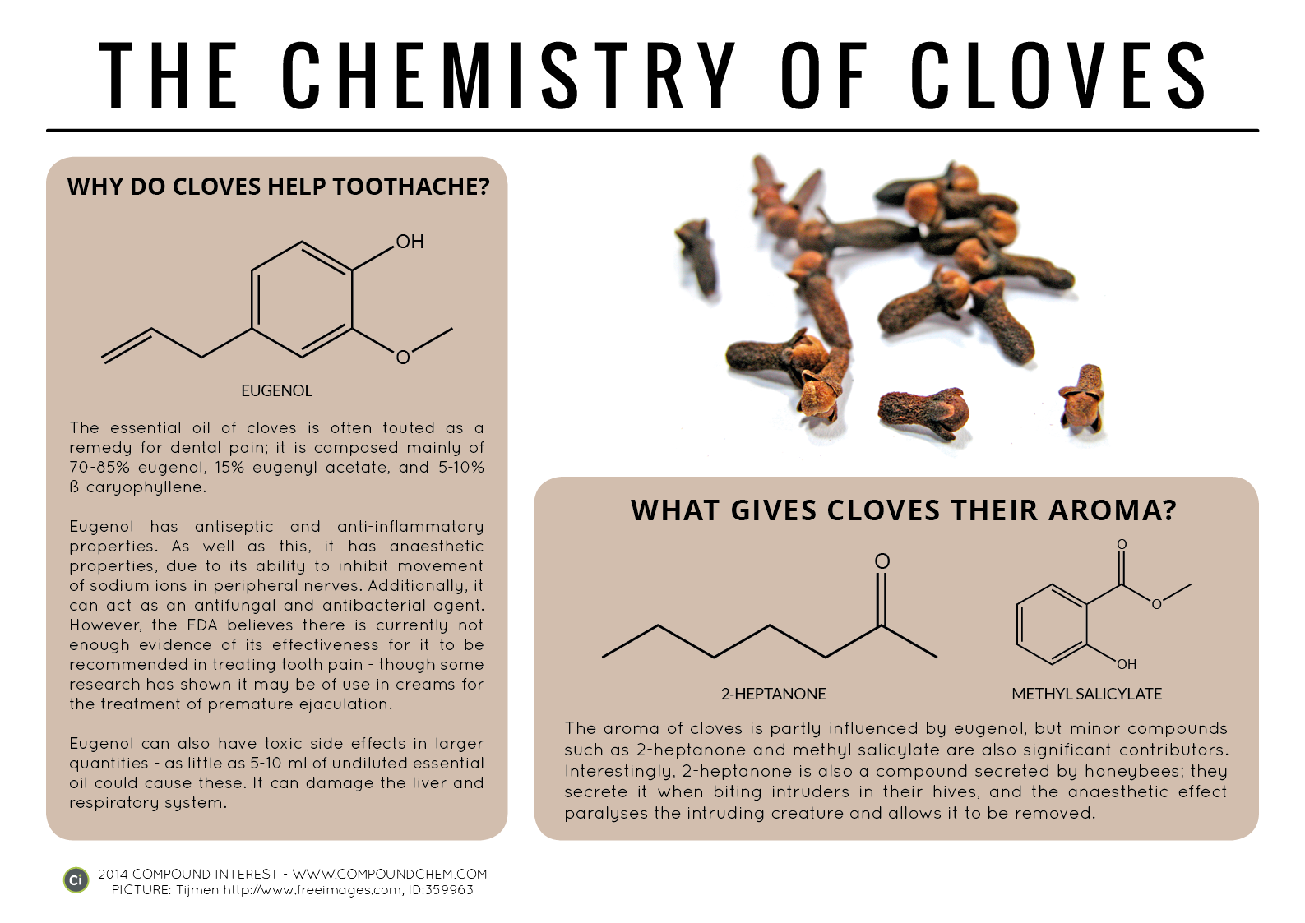
Modern research
https://www.ncbi.nlm.nih.gov/pmc/articles/PMC3819475/
https://www.researchgate.net/publication/362888775_Phytochemical_Analysis_of_Clove_Syzygium_aromaticum_Dried_Flower_Buds_Extract_and_its_Therapeutic_importance
https://www.easyayurveda.com/2013/01/21/clove-and-clove-oil-benefits-usage-dose-complete-ayurveda-details/#classical_categorization
https://ijcrt.org/papers/IJCRT2101230.pdf

Slide 20
Reference books
Bhavprakashnigahantu
Dravyaguna Vigyan by Dr. A.P.Deshpande and Dr. Subhash Ranade

